Slide 1

Modifying metals

Slide 2
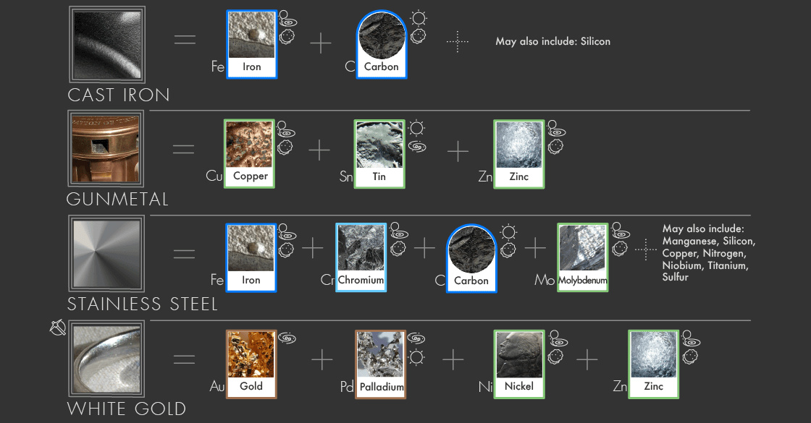
Outline
Alloys
Metal nanoparticles

Slide 3
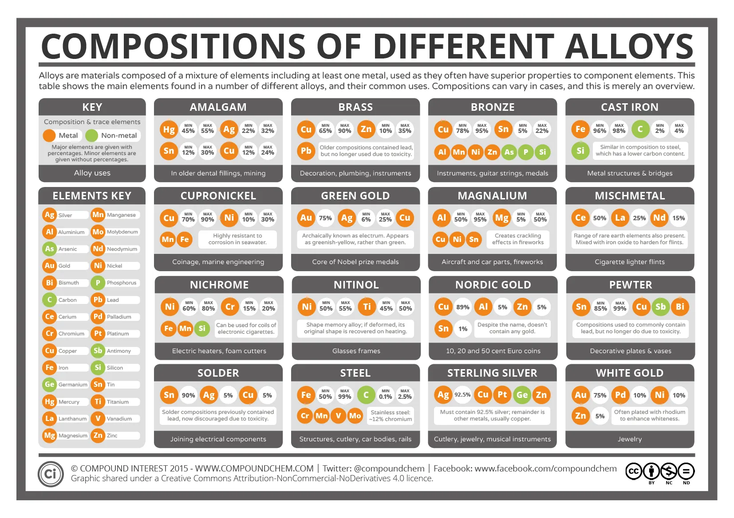

Slide 4
Alloys
Alloys are mixtures of two or more elements, at least one of which is a metal.
Brass, for example, is an alloy of copper and zinc.
Alloys are important because their properties are often superior to those of their component elements.

Slide 5
Alloys
Alloys can form from their component atoms in different ways.
If the atoms of the components in an alloy are about the same size, they can replace each other in the crystal.
This type of alloy is called a substitutional alloy.
If the atomic sizes are quite different, the smaller atoms can fit into the interstices (spaces) between the larger atoms.
Such an alloy is called an interstitial alloy.

Slide 6
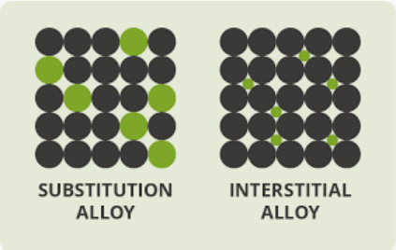
Alloys

Slide 7

Alloys
Sterling silver (92.5 percent silver and 7.5 percent copper) is harder and more durable than pure silver, yet it is still soft enough to be made into jewelry and tableware.

Slide 8
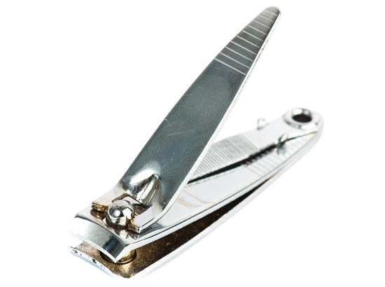
Alloys
The most important alloys today are steels.
The principal elements in most steels, in addition to iron and carbon, are boron, chromium, manganese, molybdenum, nickel,
tungsten, and vanadium.
Steels have a wide range of useful properties, such as corrosion resistance, ductility, hardness, and toughness.
Stainless Steel
80.6% Fe
18.0% Cr
0.4% C
1.0% Ni

Slide 9
Carbon steel (interstitial alloy)
Type of carbon steel | Percentage of carbon | properties | Typical use
Low-carbon steel | Less than 0.3 % | Strong. Easily shaped | Bridges, buildings, ships and vehicles
Medium-carbon steel | 0.3-0.45 % | Increased hardness and tensile strength, decreased ductility | Large machinery parts
High-carbon steel | 0.45-0.75 % | Very strong, more brittle | Springs and high-strength wires
Very high-carbon steel | Up to 2.5 % | Hard, more brittle | Cutting tools

Slide 10
Metal nanomaterials
Nanomaterial have a size between 1 – 100 nm
Metallic nanomaterials can be:
Nanoparticles
Rods
Wires
tubes

Slide 11
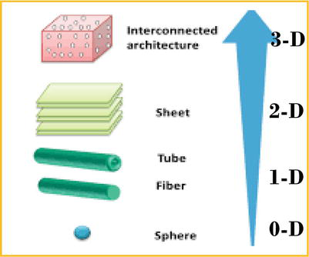
Nanomaterials
Nanoparticles – spherical, e.g. gold nanoparticles have different optical properties and red (ruby) coloured
Nanorods – have a length-width ratio of 3:1 to 5:1. Used in nanodevices and displays
Nanowires – diameter is measure on the nanoscale but the length is not restricted. Nanowires of platinum used as catalysts

Slide 12
Nanomaterials
Nanomaterials have unique electrical, catalytic, optical, mechanical, magnetic and thermal properties
Used in medicinal, electronic and engineering sectors
Read Pearson p 94 for examples of real world applications ranging from cancer research to space technology.

Slide 13
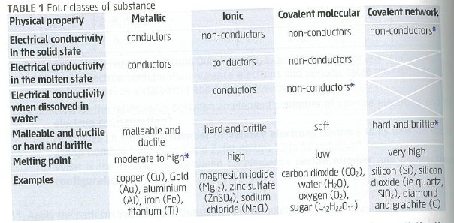
Classification of materials

